Slide 1
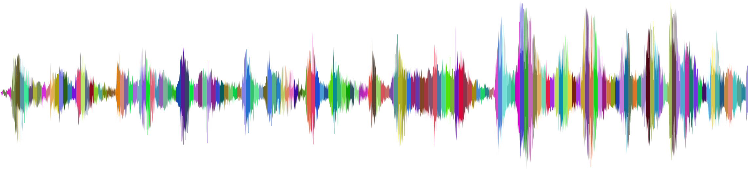
Speaker Recognition
With Celebrity Voices
Patrina T. Bailey

Slide 2
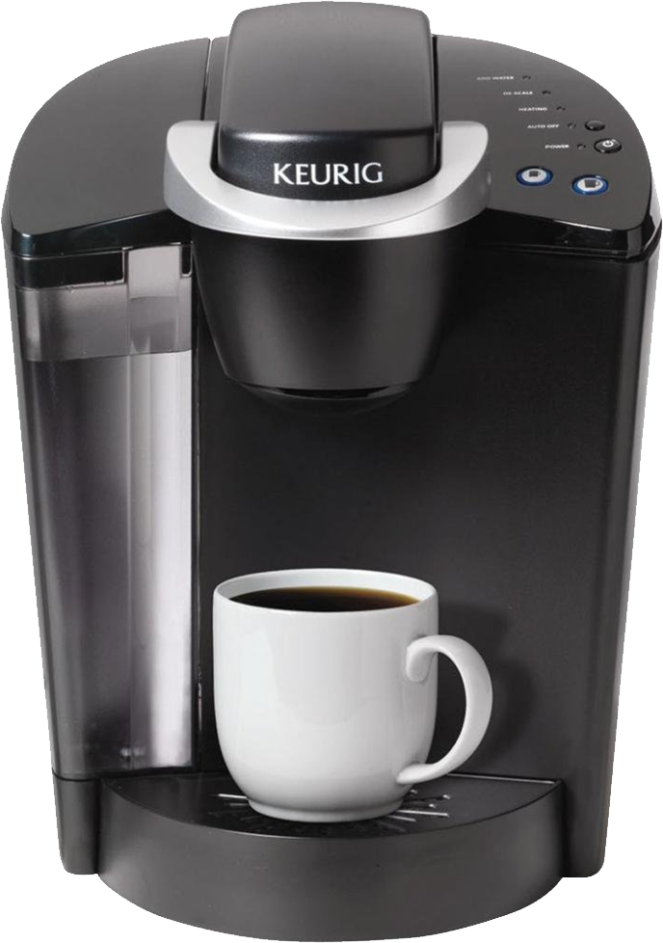

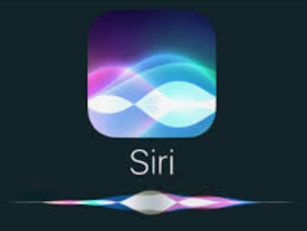
Applications
Speaker recognition enables technology to be more individualistic
Notes:
Apple’s siri is trying to detect different voices to predict behavior of each person
Machines like coffee. “Keurig, make my coffee” (from two individuals will yield different coffee types)
Profiles on individuals: Emotions detection and frequency to understand if an individual is mostly sad, or happy, etc.
NSA on tapping your phone

Slide 3
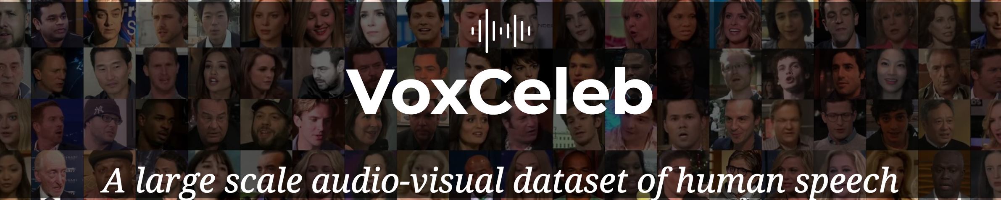
Data
537 individuals
64,483 audio clips
5 features

Slide 4
Librosa Library
MFCC
Chroma
Melspectrogram
Spectral Contrast
Tonnetz
Chroma: an attribute of pitches, just like hue is an attribute of color. - wiki
Mel-frequency cepstral coefficients (mfcc): “coefficients that make up an MFC. MFC is a representation of the short-term power spectrum of a sound, based on a linear cosine transform of a log power spectrum on a nonlinear mel scale of frequency” - wiki
Dont worry about it
Melspectrogram: a scale constructed from how human listeners “judged” pitch differentiation
Spectral Contrast: level difference between peaks and valleys in the spectrum
Tonnetz: takes harmonic content, and projects collections of pitches as Tonal Centroid points in a 6-D space
Notes:
mfcc: Mel-frequency cepstral coefficients are coefficients that collectively make up an MFC
melspectrogram: Compute a Mel-scaled power spectrogram
chorma-stft: Compute a chromagram from a waveform or power spectrogram
in music, the term chroma feature or chromagram closely relates to the twelve different pitch classes. Chroma-based features, which are also referred to as "pitch class profiles", are a powerful tool for analyzing music whose pitches can be meaningfully categorized and whose tuning approximates to the equal-tempered scale.
In music, a pitch class (p.c. or pc) is a set of all pitches that are a whole number of octaves apart, e.g., the pitch class C consists of the Cs in all octaves. "The pitch class C stands for all possible Cs, in whatever octave position
spectral_contrast: Compute spectral contrast
Spectral contrast is defined as the level difference between peaks and valleys in the spectrum
tonnetz: Computes the tonal centroid features (tonnetz), following the method of [2]. harmonic content

Slide 5
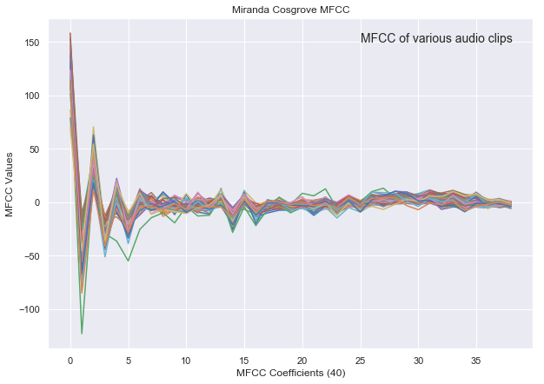
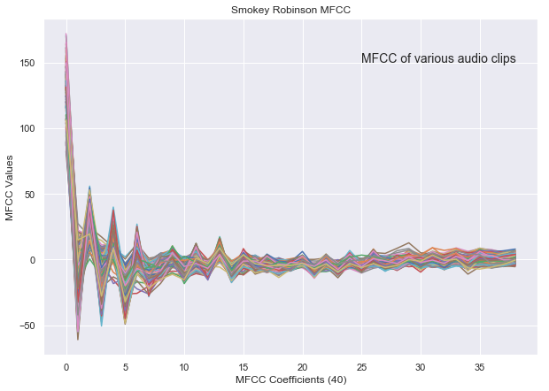
Features:
MFCC
Cosgrove’s range from -125 to ~150
Robinson’s range from -60 to ~150

Slide 6
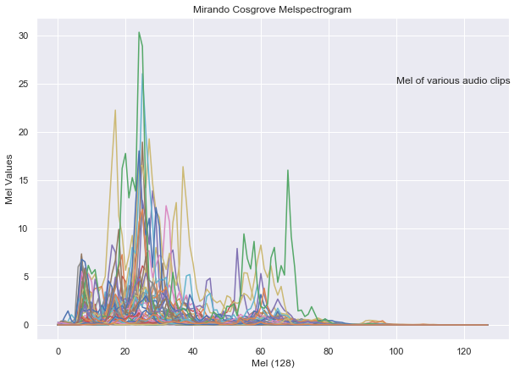
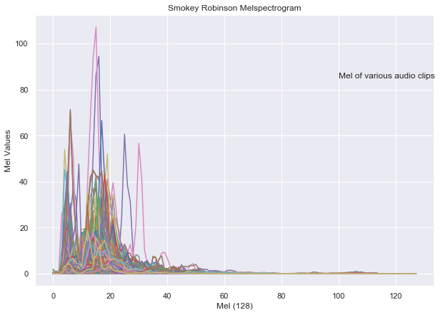
Mel
Cosgrove’s max is ~30 and high values range from 5 to 70
Robinson’s max is ~100 and high values range from 0 to 30

Slide 7
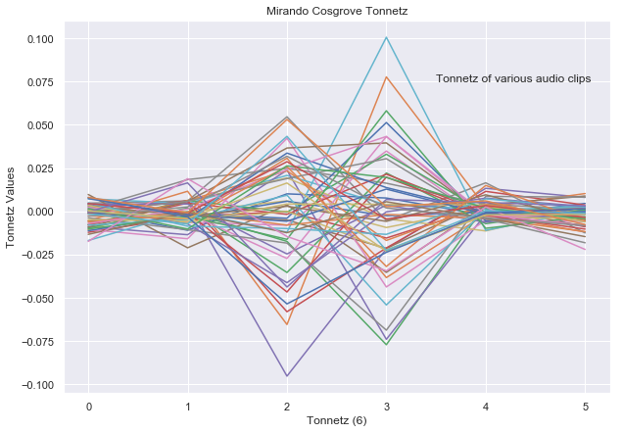
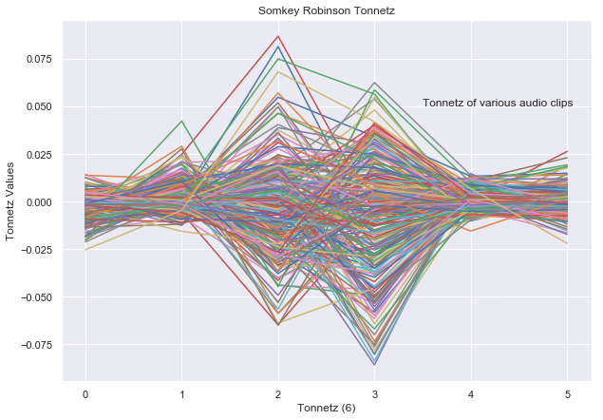
Tonnetz
Cosgrove’s range from -0.1 to 0.1
Robinson’s range from -0.075 to 0.075

Slide 8
Using supervised deep learning

Slide 9
Models and Metrics
Models | Recall | Accuracy | Precision | F1 Score
PReLU-19 | 0.707 | 0.707 | 0.724 | 0.702
SeLU-15 | 0.696 | 0.696 | 0.715 | 0.693
Leaky ReLU CNN-11 | 0.640 | 0.640 | 0.667 | 0.639
PReLU CNN-15 | 0.678 | 0.678 | 0.708 | 0.675
SeLU CNN-18 | 0.733 | 0.733 | 0.750 | 0.730

Slide 10
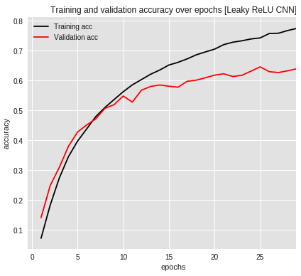
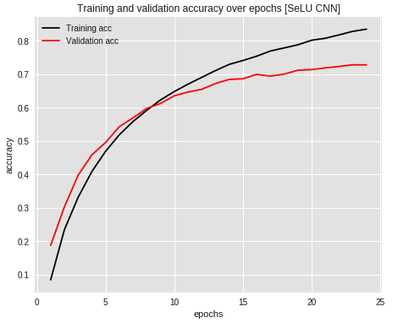
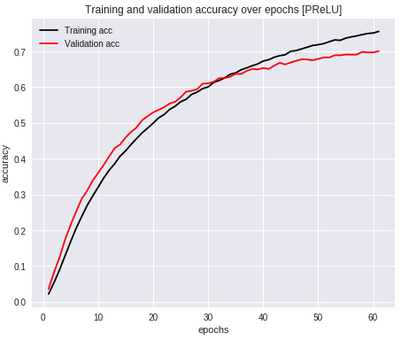
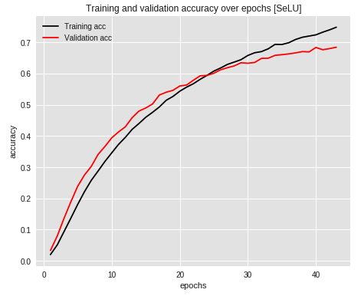
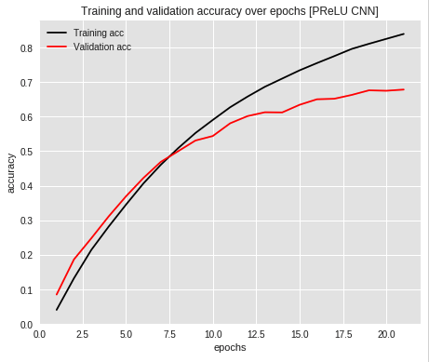
Accuracy Score when Training
PReLU
SeLU
Leaky ReLU CNN
PReLU CNN
SeLU CNN

Slide 11
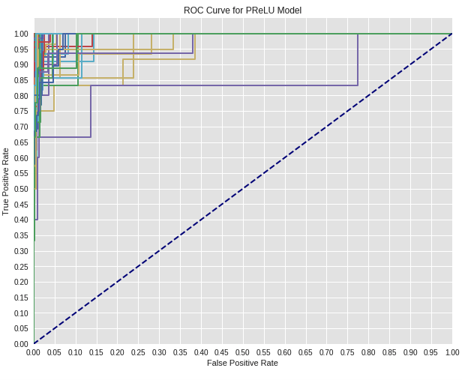
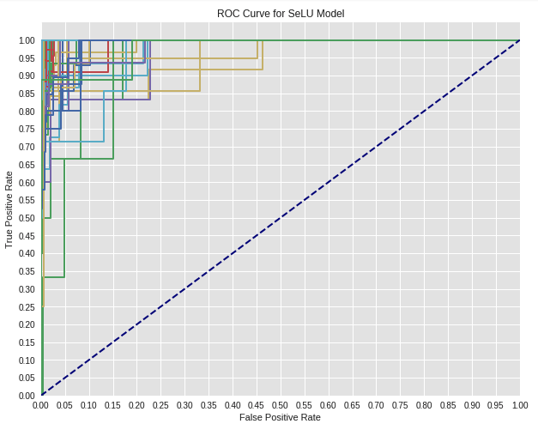
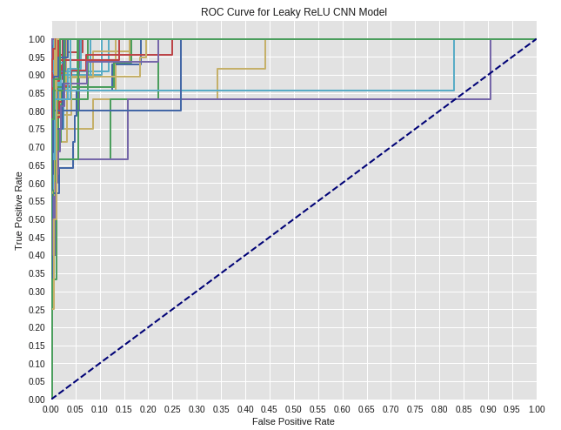
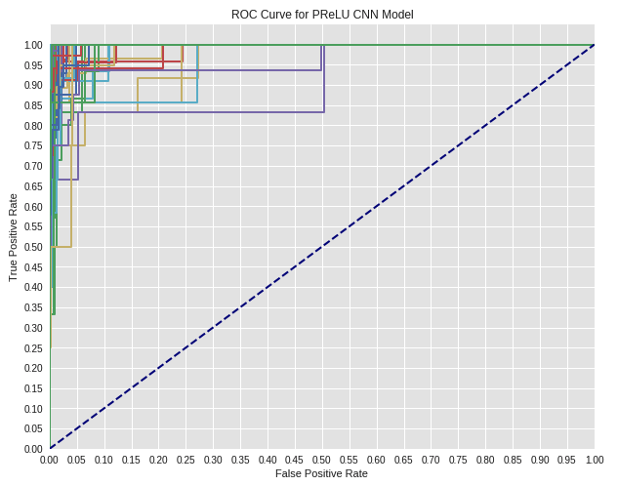
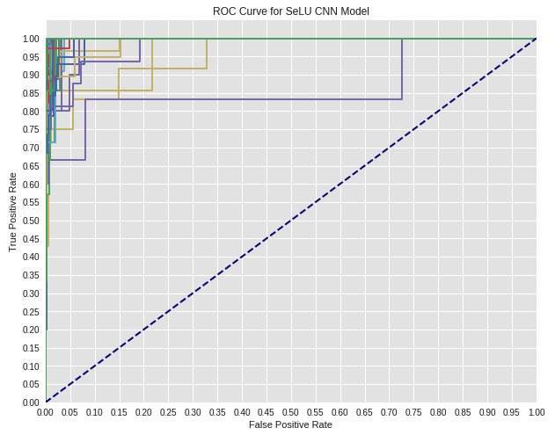
ROC Curves

Slide 12
Next Steps
Make machine more human
Add more individuals
Try more models
talos for advanced activation
non-NN classifications
Add more/different features
Feature engineering
Notes:
Because my model outputs probability of the audio clip being certain people, I’d like my machine to have thresholds where
if a prob > threshold, machine : “that’s this person for sure”
If prob. < threshold, machine: “i’m not sure who this is”
-prob. In btw. Thresholds, machine: “i think it’s this person”
Becau

Slide 13
DEMO

Slide 14
